Slide 1
Test 16 classes

Slide 2
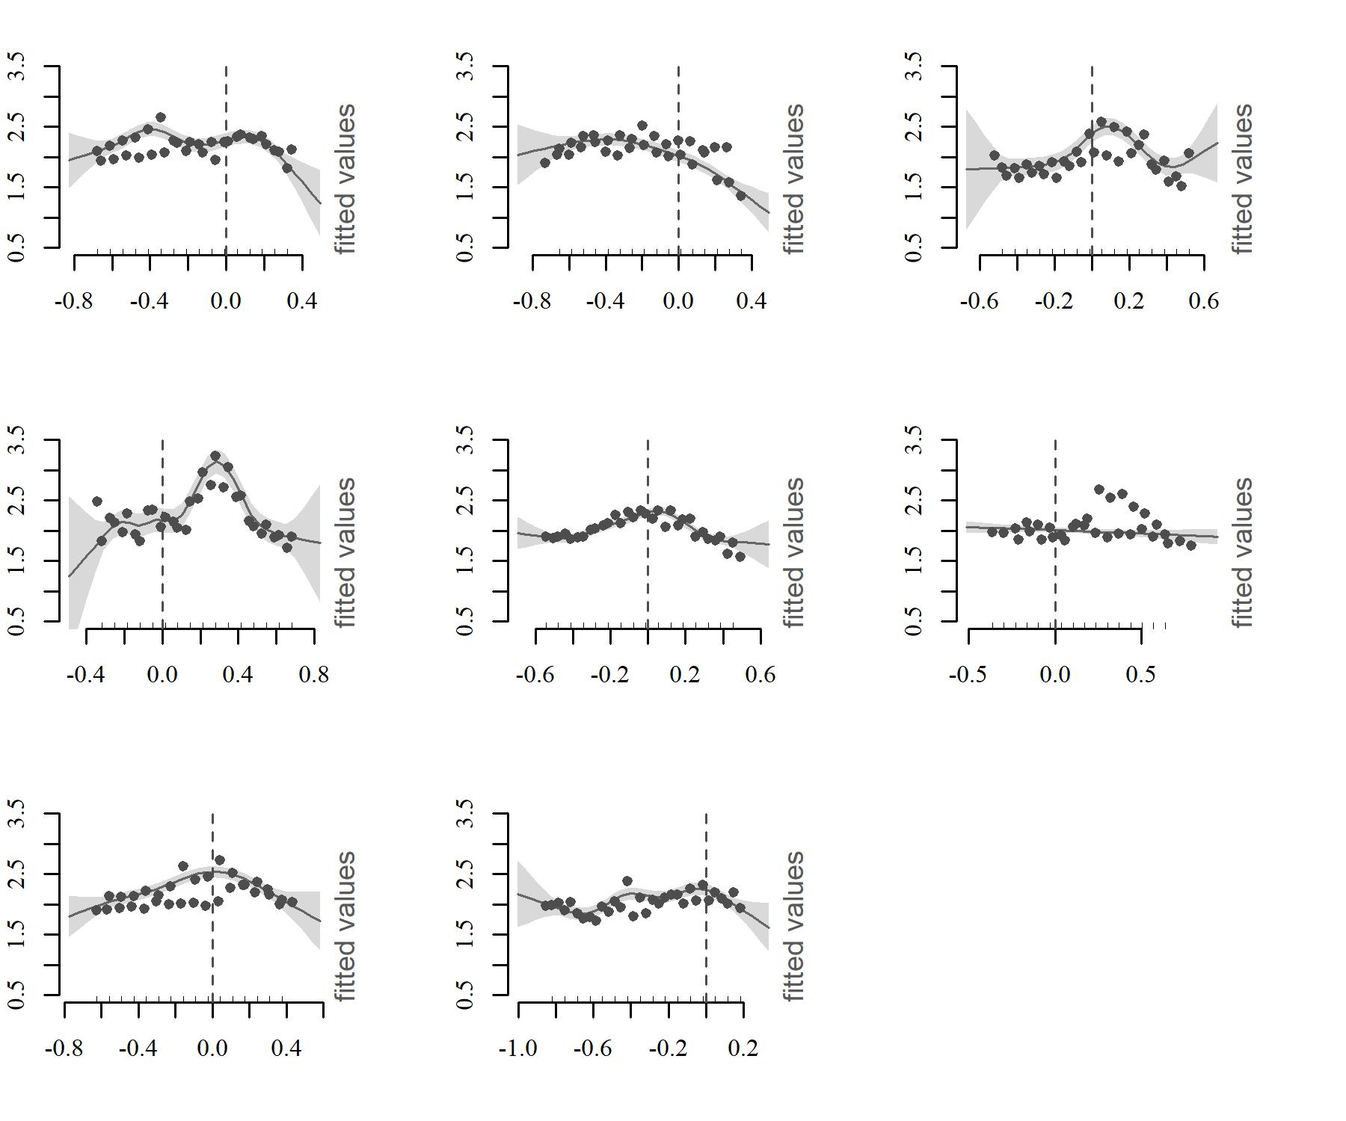
(a) Herring
(b) Cod
(c) Haddock
(d) Whiting
(e) Saithe
(f) Mackerel
Taylor’s exponents
(g) Sprat
(h) Norway pout
Standardized length

Slide 3
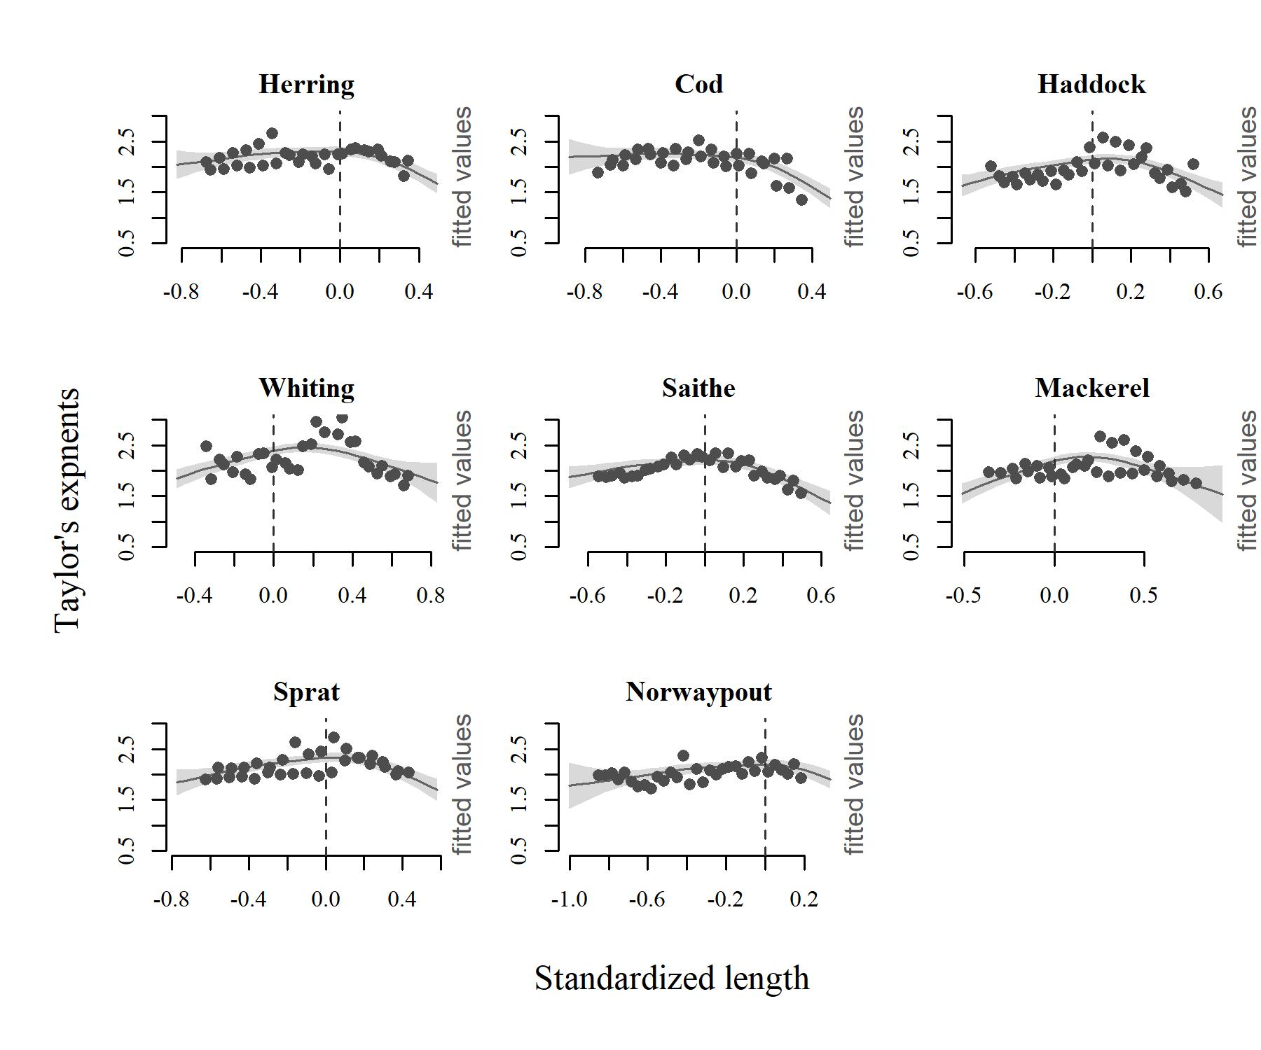
(a) Herring
(b) Cod
(c) Haddock
(d) Whiting
(e) Saithe
(f) Mackerel
(g) Sprat
(h) Norway pout

Slide 4
Hump shape peak

Slide 5
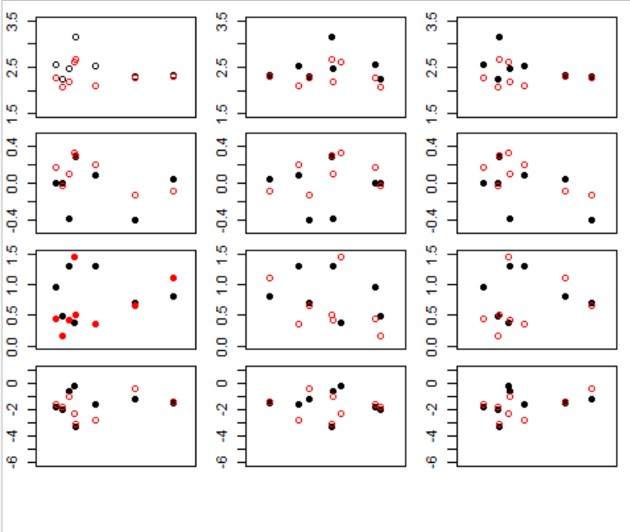
Hump shape slope
Life history traits
max
b value
peak
location
uphill
slope
Downhill
slope
Linf K Lmature

Slide 6
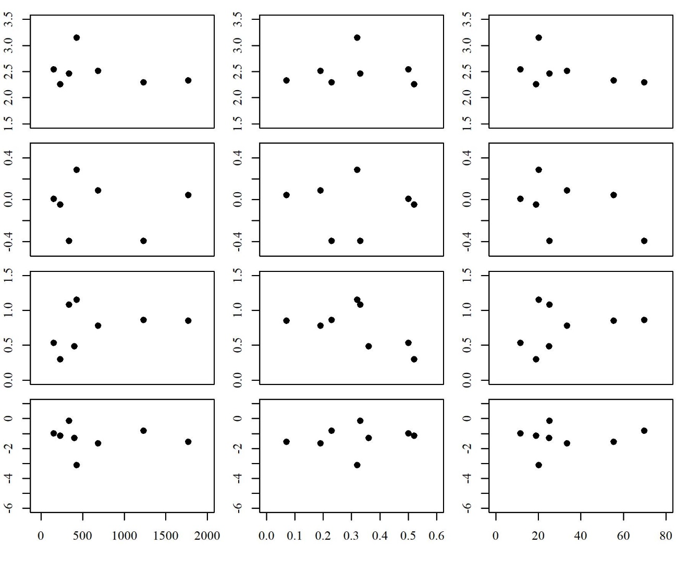
Maximum
b value
Peak location
(std_L)
Uphill slope
Downhill slope
L_{inf}
K
L₅₀

Slide 7
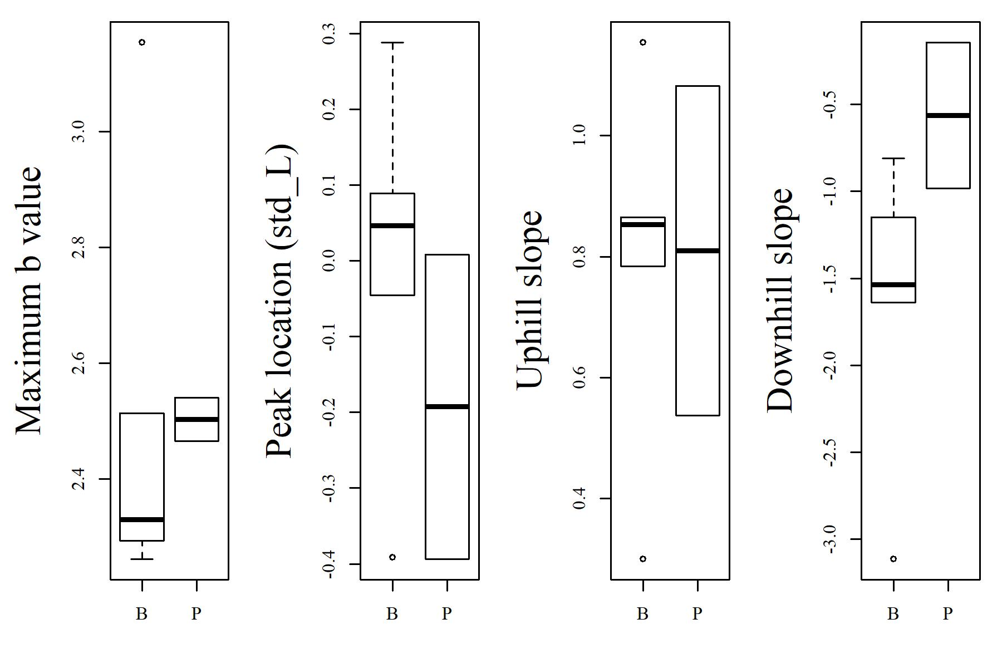
(a)
(b)
(c)
(d)
Maximum b value
Life style

